Slide 1
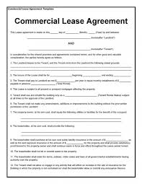
Hire-purchase and leasing
Types and Salient features
Assignment-2 (FIM), Autumn 2020
Presentation date - ?? OCT 2020
Group 12
Aniket Niranjan Mishra, 17MT3FP20
Atharva Wagle, 17CH3FP07
Umang Pandey, 19ME10075

Slide 2
01
HIRE-PURCHASE
02
LEASING
CONTENTS
Page No. 3-14
Page No. 15-38

Slide 3
01.
HIRE-
PURCHASING
If you can’t afford it all at once, maybe you want to disperse the payments?

Slide 4
WHAT IS HIRE-PURCHASING?
A system under which term loans for the purchase of good and services are advanced through a contractual obligation.
This concept originated in the UK, first introduced by Hentry Moore, a piano maker in 1846.
The buyer makes an initial down payment and pays the balance plus interest in instalments, rather than making the whole payment at the time of buying.
The instalments typically cover the depreciation of the asset, and interest covers the capital cost.
It is an important source of financing in recent times. It provides a convenient way to afford and acquire assets that otherwise be financially unattainable. Thus, hire purchase also helps a nation’s economy to grow further.
.

Slide 5
Common names of hire-PURCHASING
HIRE-PURCHASINg: UK
INSTALMENT PLAN: USA
Key point: Ownership of the good is not transferred to the buyer until he clears all his dues. The seller retains the right to repossess the good should the seller fail to clear all his dues.
Also known as a rent-to-own agreement.
Key point: The ownership is immediately transferred once the loan contract is signed.

Slide 6
FEATures of a typical hire-purchase agreement
Rental payments are paid in installments over the period of the agreement.
If the hirer defaults on any payment, the seller has right to take back the assets.
If the hirer does not want to own the asset, he can return the assets any time and is not required to pay any installment that falls due after the return.
However, once the hirer returns the assets, he cannot claim back any payments already paid as they are the charges towards the hire and use of the assets.
The hirer cannot pledge, sell or mortgage the assets as he is not the owner of the assets till the last payment is made.
The hirer, usually, pays a certain amount as an initial deposit / down payment while signing the agreement.

Slide 7
TIMELINE of a typical hire-purchase agreement
1.
2.
4.
6.
Seller sells goods to Financing/Hire-Purchase (HP) Co.
3.
5.
Buyer makes down payment and takes possession.
Ownership transfers from HP Co. to the buyer/hirer.
HP Co. lets goods on hire to buyer/hirer.
Hirer makes all the agreed instalments.
Process complete.

Slide 8
Advantages of hire-purchase
FAST & AFFORDABLE
EASY TO MANAGE
DEPRECIATION?
NO ISSUES
Immediate use of assets without paying the entire amount.
Fixed rental payments make budgeting easier as all the expenditures are known in advance.
No need to worry about the asset depreciating quickly in value as there is no obligation to buy the asset.

Slide 9
DISAdvantages of hire-purchase
COSTLY IN THE LONG RUN
NO IMMEDIATE OWNERSHIP
UNEXPECTED STRATEGY CHANGES
Total amount paid towards the asset could be much higher than the cost of the asset due to substantially high-interest rates.
Ownership only at the end of the agreement. The hirer cannot modify the asset till then.
If the hired asset is no longer needed because of any change in the business strategy, there may be a resulting penalty.

Slide 10
TYPES OF HIRE-PURCHASE
DIRECT
INDIRECT
Hire-purchase agreements are categorised based on who gets into an agreement with the seller.
We have the following 2 types :
Purchaser himself enters into this agreement with the seller and pays instalments to the seller.
Credit risk is assumed by the seller.
The third entity (lender, a financial institution) purchases goods on behalf of the customer and gets into this agreement with the customer.
The lender owns the ownership of goods, pays the purchase price to the seller and get it recovered from the customer.
Credit risk is assumed by the lender.

Slide 11
HIRE-PURCHASE IS BEST SUITABLE FOR?
Small scale companies and entrepreneurs can benefit from Hire Purchase. Expensive and important assets can be hired and later owned. This ensures that they can start using the asset from very first day and use the money earned to later buy the same assets.

Slide 12
INDIAN SCENARIO ON HIRE-Purchase
Hire-purchase is governed by the Hire Purchase Act, 1972.
Hire-purchase credit is available for a wide range of products and services ranging from consumer durables like automobiles, sewing machines, refrigerators to services like educational and medical fees.
A large part of instalment credit in India is given for the purchase of commercial vehicles.

Slide 13
WHAT ALL CAN YOU BUY USING HIRE-PURCHASE IN INDIA?
AC
HEAVY
machinery
TV SETS
AUTOMOBILES
EDUCATION
Refrigerator
HP
SEWING MACHINES
jewellery
MEDICINE
SMARTPHONES
FURNITURE
COmputer

Slide 14
02.
LEase Financing
Thinking of adding to that asset column? Here’s a way to do more or ‘lease’ the same.

Slide 15
WHAT IS LEASE FINANCING?
Lease financing is one of the most important sources of medium and long term financing.
It is a contractual agreement between the owner of the assets and user of the assets.
The owner, called the lessor, permits the user, called the lessee, to economically use the asset on the payment of a periodical amount which is in the form of lease rent for a specific period of time.
The title of goods remains with the owner (lessor) of the asset.
Under the written leasing agreements, the company acquires the right to use the asset without holding the title to it.

Slide 16
CONTENTS OF A LEASE AGREEMENT
01
02
03
04
Description and cost of equipment
Commencement date for lease contract.
Amount of lease rentals
Mode of Payments
Fixed period of lease, renewal options and the terms during secondary period as to the amount of lease rentals or purchase option.
Guarantee for payment of lease rental by lessee.
Variation of lease rentals.
Termination of lease agreement in the event of certain occurrences.

Slide 17
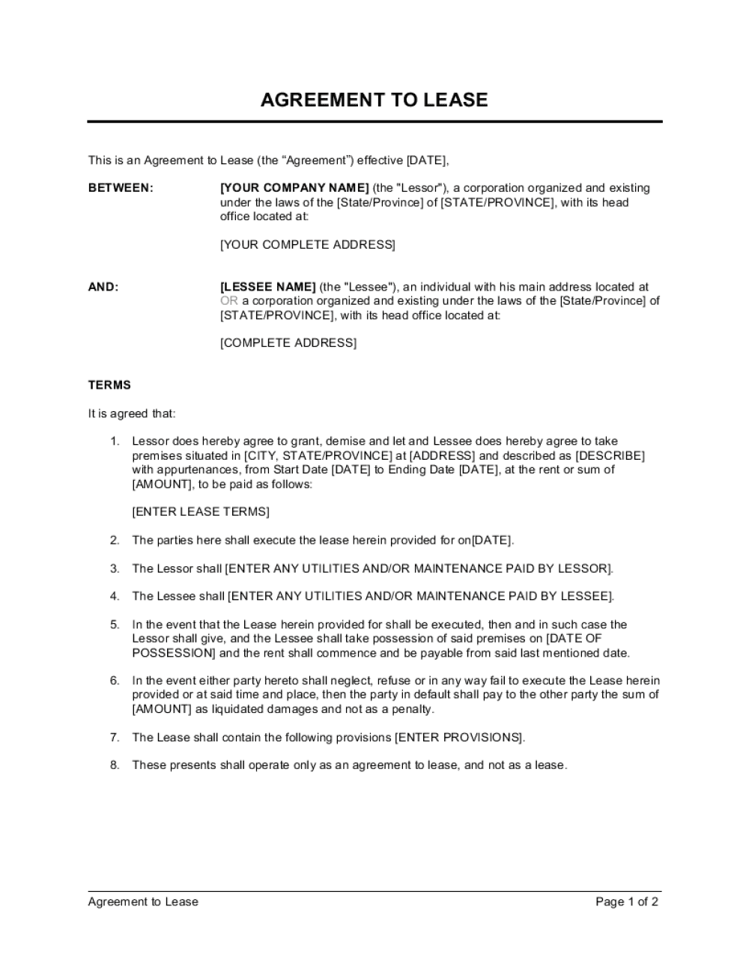
How a lease contract looks

Slide 18
TYPES OF LEASES
OPerating lease
Finance lease
Leases are categorised based on transfer of risk and rewards to the lessee, the period of lease and the number of parties to the transaction. We have the following 2 types :

Slide 19
Finance lease
It is the lease where the lessor transfers substantially all the risks and rewards of ownership of assets to the lessee for lease rentals. In other words, it puts the lessee in the same con­dition as he/she would have been if he/she had purchased the asset. Finance lease has two phases: The first one is called primary period. This is non-cancellable period and in this period, the lessor recovers his total investment through lease rental. The primary period may last for indefinite period of time. The lease rental for the secondary period is much smaller than that of primary period.

Slide 20
Two phases of a financial lease
Primary period
Secondary period
This is the non-cancellable period and in this period, the lessor recovers his total investment through lease rental and this period may last for an indefinite period of time.
This period is also known as a peppercorn. It is almost the same as the primary period but in this period the lease rental is much smaller than that of primary period.

Slide 21

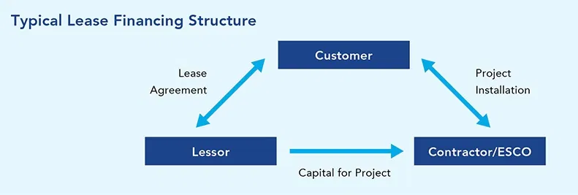

Slide 22
Features of a finance lease
right
Investment recovery
size
Asset maintenance
Risk and rewards
Non-cancellable
A finance lease is a device that gives the lessee a right to use an asset.
The lease rental charged by the lessor during the primary period of lease is sufficient to recover his/her investment.
The lease rental for the secondary period is much smaller. This is often known as peppercorn rental.
Lessee is responsible for the maintenance of asset.
No asset-based risk and rewards is taken by lessor.
Such type of lease is non-cancellable; the lessor’s investment is assured.

Slide 23
operating lease
Leases other than finance leases are called operating leases. Here risks and rewards incidental to the ownership of asset are not transferred by the lessor to the lessee. The term of such lease is much less than the economic life of the asset and thus the total investment of the lessor is not recovered through lease rental during the primary period of lease. In case of operating lease, the lessor usually provides advice to the lessee for repair, maintenance and technical knowhow of the leased asset and that is why this type of lease is also known as service lease.

Slide 24
Features of a operating lease
term
right
Technical know-how
Risk and rewards
Investment recovery
The lease term is much lower than the economic life of the asset.
The lessee has the right to terminate the lease by giving a short notice and no penalty is charged for that.
The lessor provides the technical knowhow of the leased asset to the lessee.
Risks and rewards incidental to the ownership of asset are borne by the lessor.
Lessor has to depend on leasing of an asset to different lessee for recovery of his/her investment.

Slide 25
Differences between the two types of leases
 | Operating Lease | Financial Lease
ownership | With the lessor | Transfer option at the end of the lease period is with the lessee
Risks and rewards | With the lessor | With the lessee
Purchase option | Does not have any option | The lessee has a purchase option
Expenses borne | By lessor | By lessee

Slide 26
Advantages of leasing
Leasing has shown an increasing trend and appears to be a cost effective alternative for using an asset.

Slide 27
Advantages to lessor
Assured regular income
Preservation of ownership
Benefit of tax
Lessor gets lease rental by leasing an asset during the period of lease which is an assured and regular income.
In case of finance lease, the lessor transfers all the risk and rewards incidental to ownership to the lessee without the transfer of ownership of asset hence the owner­ship lies with the lessor.
As ownership lies with the lessor, tax benefit is enjoyed by the lessor by way of depreciation in respect of leased asset.

Slide 28
Advantages to lessor
High profitability
High potentiality of growth
Recovery of investment
The demand for leasing is steadily increasing because it is one of the cost efficient forms of financing. Economic growth can be maintained even during the period of depression. The growth potential of leasing is much higher as compared to other forms of business.
The business of leasing is highly profitable since the rate of return based on lease rental, is much higher than the interest payable on financing the asset.
In case of finance lease, the lessor can recover the total investment through lease rentals.

Slide 29
Advantages to lessee
Use of capital goods
Tax benefits
cheaper
A company is able to enjoy the tax advantage on lease payments as lease payments can be deducted as a business expense.
A business will not have to spend a lot of money for acquiring an asset but it can use an asset by paying small monthly or yearly rentals.
Leasing is a source of financing which is cheaper than almost all other sources of financing.

Slide 30
Advantages to lessee
Technical assistance
Inflation friendly
ownership
Leasing is inflation friendly, the lessee has to pay fixed amount of rentals each year even if the cost of the asset goes up.
Lessee gets some sort of technical support from the lessor in respect of leased asset.
After the expiry of primary period, lessor offers the lessee to purchase the assets— by paying a very small sum of money.

Slide 31
disAdvantages of leasing
.

Slide 32
disAdvantages to lessor
Unprofitable in inflation
Double taxation
Greater chance of damaging asset
Sales tax may be charged first at the time of purchase of asset and second at the time of leasing the asset.
Lessor gets fixed amount of lease rental every year and they cannot increase this even if the cost of asset goes up.
As ownership is not transferred, the lessee uses the asset carelessly and there is a great chance that asset cannot be useable after the expiry of primary period of lease.

Slide 33
disAdvantages to lessee
compulsion
costly
ownership
Lease financing is more costly than other sources of financing because lessee has to pay lease rental as well as expenses incidental to the ownership of the asset.
Finance lease is non-cancellable and even if a company does not want to use the asset, lessee is required to pay the lease rentals.
The lessee will not become the owner of the asset at the end of lease agreement unless he decides to purchase it.

Slide 34
FInancial institutions involved in leasing activities
Non banking finance companies
Car finance companies and cab aggregators
Non banking non-financial companies
Indian railway finance corporation

Slide 35
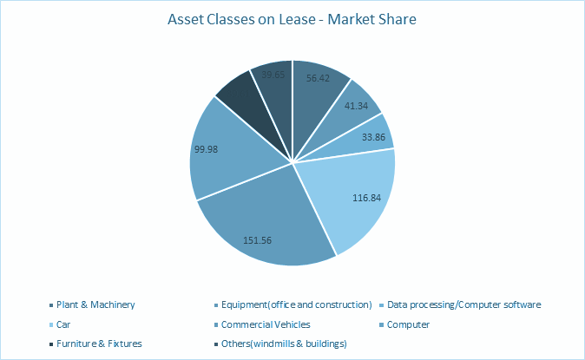
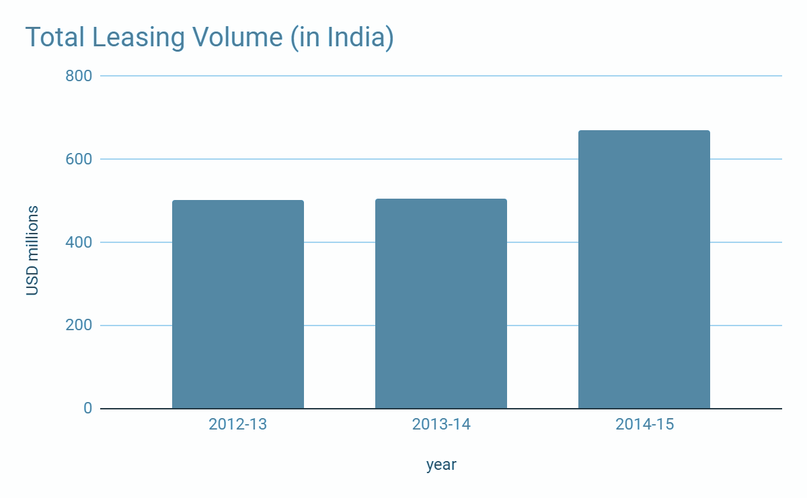
Leasing data
579.26 m USD

Slide 36
646,000
162 Billion euros
170,000
Number of persons involved in Leasing activities in Europe
Turnover of Leasing sector in Europe
Number of Leasing enterprises

Slide 37

TOP LEASING AND HIRE-PURCHASE companies in india
As is clear from the adjoining map, public/private limited/partnership firms giving credit for the purchase of durable goods are prevalent in South India. The sources of funds for such firms are: Deposits from public and borrowings from banks. If consolidated, the possibility to raise funds from public issues (IPOs and FPOs) is also there.
Bajaj Finance
M&M Financial
Shriram Transport
Shriram City
Cholamandalam
Manappuram Fin
Magma Fincorp
Sundaram Fin
Capital Trust
SREI Infra
9
7
10
1
2
3
4
(The numbers on the map represent the headquarter locations of the mentioned companies.)
8
5
6

Slide 38
LEASE FINANCING vs hire-purchasing
Lease financing
hire- purchasing
Ownership lies with the lesser.
The depreciation is claimed as an expense in the books of lessor.
The rentals cover the cost of using an asset.
Lease agreements are generally done for longer duration and for bigger assets like land, property etc.
The total lease rentals are shown as the expenditure by the lessee in the lease agreement.
Repairs and maintenance of the asset in financial lease is the responsibility of the lessee but in operating lease, it is the responsibility of the lesser.
The hirer has the option to purchase.
The depreciation claim is allowed to the hirer.
The installment is inclusive of the principal amount and the interest for the time period the asset is utilized.
These agreements are done mostly for shorter duration and cheaper assets like hiring a car, machinery etc.
In hire purchase, the hirer claims the depreciation of asset as an expense.
In hire purchase, the responsibility lies with the hirer.

Slide 39
THANKS
Does anyone have any questions?
Feel free to reach us at:-
aniket.mishra1203@gmail.com
atharva.wagle@gmail.com
umangpandey07@gmail.com

